Slide 1
Predicting 2016-2017 Season the ALL-NBA teams
David Roh
Notes:
This template can be used as a starter file for presenting training materials in a group setting.
Sections
Sections can help to organize your slides or facilitate collaboration between multiple authors. On the Home tab under Slides, click Section, and then click Add Section.
Notes
Use the Notes pane for delivery notes or to provide additional details for the audience. You can see these notes in Presenter View during your presentation.
Keep in mind the font size (important for accessibility, visibility, videotaping, and online production)
Coordinated colors
Pay particular attention to the graphs, charts, and text boxes.
Consider that attendees will print in black and white or grayscale. Run a test print to make sure your colors work when printed in pure black and white and grayscale.
Graphics, tables, and graphs
Keep it simple: If possible, use consistent, non-distracting styles and colors.
Label all graphs and tables.

Slide 2
Table of Contents
The question – Who’s the most likely candidate to be awarded with the honor?
The data – Historical look at the individual achievements
The analysis – What does history tell us?
The result – so… who?

Slide 3
Hypothesis
What’s wrong with it?
With 2011 Collective Bargaining Agreement in place, now player’s contractual bonus is tied to the performance awards which includes the all-NBA team selection.
This award is purely based on the impact that they made on floor when they play, unlike other awards that can turn into a popularity contest.

Slide 4
Hypothesis
What is it?
At the end of regular season, the league (NBA) selects 3 teams of 5 players of each position, and award them with the first/second/third team title.
This award goes to the top player in each position category set forth by the league.
Notes:
Give a brief overview of the presentation. Describe the major focus of the presentation and why it is important.
Introduce each of the major topics.
To provide a road map for the audience, you can repeat this Overview slide throughout the presentation, highlighting the particular topic you will discuss next.

Slide 5
Hypothesis – the Q
Hypothesis –
Which individuals performed the best that deserved to be included in the all-NBA teams?

Slide 6
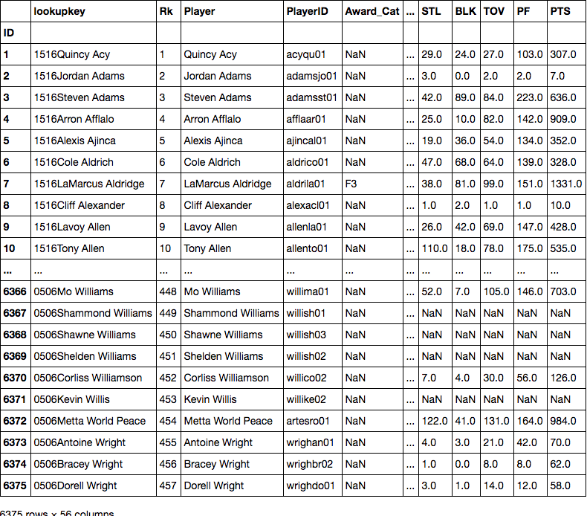
The Data

Slide 7
The Data
What are we looking at?
With 56 columns of different data for each individual athletes, build the model using historical data dating back to the past decade.
Combined of regular season total
The model will then applied to the current 2016-2017 season, and predict the selection.
Notes:
Give a brief overview of the presentation. Describe the major focus of the presentation and why it is important.
Introduce each of the major topics.
To provide a road map for the audience, you can repeat this Overview slide throughout the presentation, highlighting the particular topic you will discuss next.

Slide 8
The Analysis

Slide 9

So… Who?

Slide 10

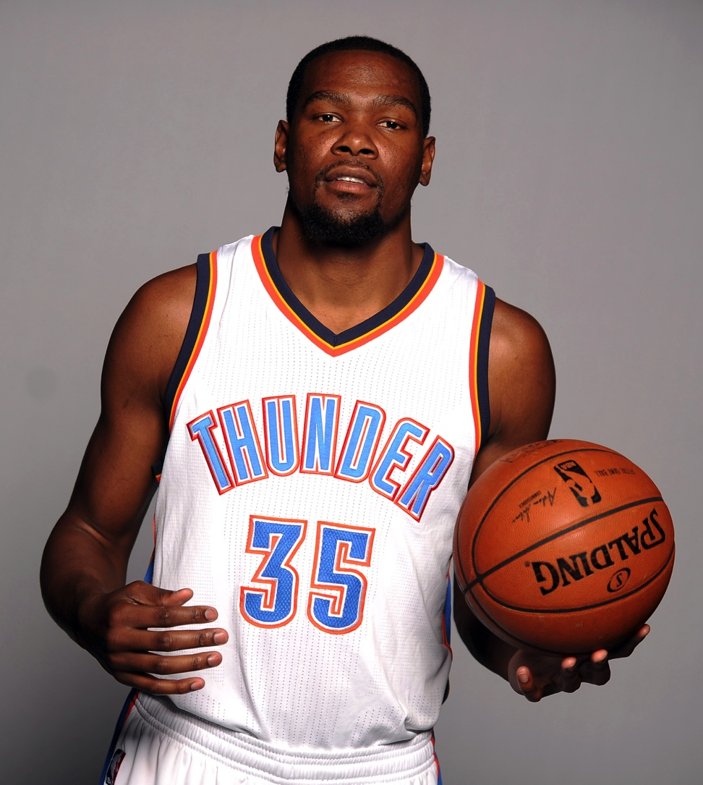
So… Who?

Slide 11

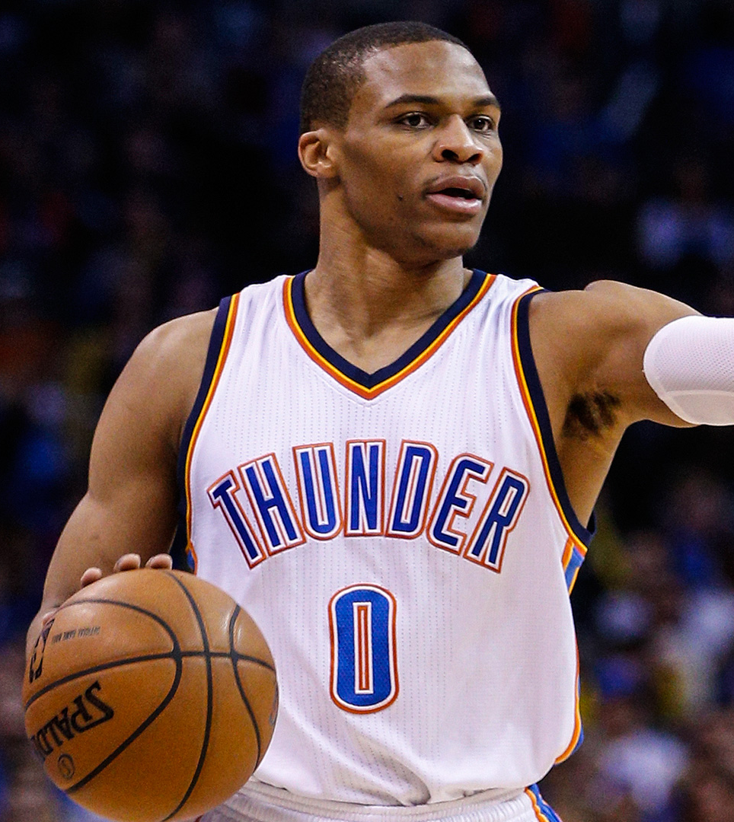
So… Who?

Slide 12

So… Who?

Slide 13

Last, but not least

Slide 14
What can be better?
Exploratory Data Analysis
More usable columns still left within the initial data frame. Potential is still there.
Feature Engineering
Advanced stats addressed many of feature engineering ideas, such as PER, USG%, TS%.
Making prediction DF into full season stat

Slide 15
Questions?

